Slide 1
HLS Hero Workshop
Course Workbook

Slide 2
Table of Contents
About this Workbook | Page 3
Pre-Lab: Workshop Pre-requisites | Page 4
Lab 1: Vitis HLS Flow | Page 7
Lab 2: Vitis HLS Interfacing | Page 48
Lab 3: Vitis HLS Optimization | Page 63
Lab 4: Vitis HLS Arbitrary Precision Math | Page 79
Lab 5: Vitis HLS Vitis Libraries | Page 89

Slide 3
About this Workbook
The contents of this workbook are created by Adiuvo Engineering & Training, Ltd.
If you have any questions about the contents, or need assistance, please contact Adam Taylor at adam@adiuvoengineering.com.

Slide 4
Pre-Lab HLS Hero

Slide 5
Required Hardware
Pre-Lab
None Required

Slide 6
Downloads and Installations
Pre-Lab
Step 1 – Download and install the following at least 1 day prior to the workshop. This may take a significant amount of time and drive space.
Watch the video available here to show how to configure the installation
Vitis 2021.2 | Download

Slide 7
Lab 1 Vitis HLS Flow

Slide 8
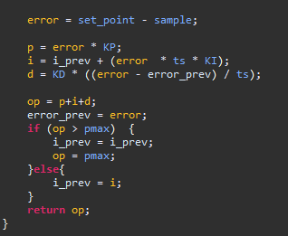
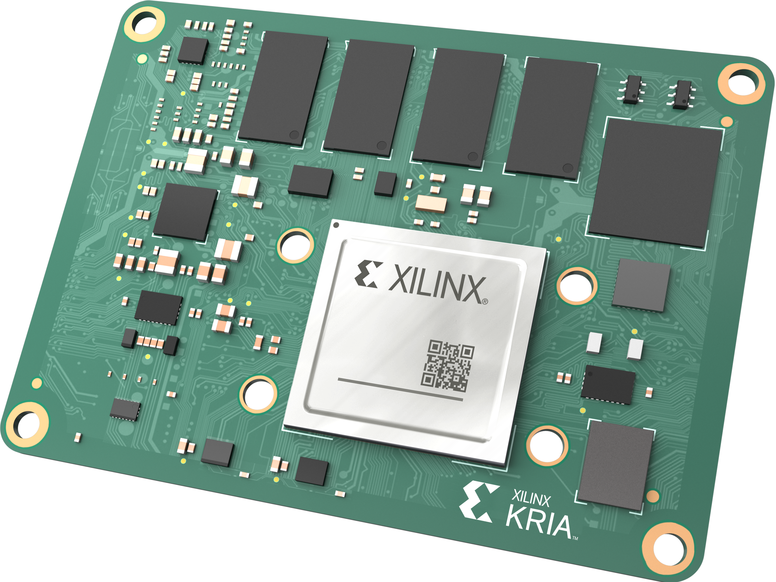
What is HLS
High Level Synthesis (HLS) enables generation of RTL modules from higher level language such as C, C++, OpenCL
Of course, SW engineers still consider these low-level languages.
HLS offers several benefits for the development of Signal / Data / Image processing algorithms

Slide 9

HLS Benefits
Seconds / Minutes Iteration
Developing in Higher Level language enables a faster iteration time.
Development Time decreased as untimed language – No RTL / Behavioral level
Increased level of abstraction – accelerates development
Verification time is reduced as untimed Simulation
C Design
Hours / Days Iteration
RTL
RTL
Verified RTL
Verified RTL

Slide 10
Creating HLS Solutions
Software written for CPUs and software written for FPGAs is fundamentally different
Not all C constructs can be synthesised
Learn about synthesizable C/C++ coding styles.
Need to focus on correct micro architecture
Understand the producers and consumers
Decompose the algorithm into small section which interconnect
Understand throughput required for each element to achieve overall performance goals
Learn how to interpret the design reports

Slide 11
HLS Flow
Create Solution, Simulate & Debug
Synthesize
Analyse & Optimize
Package the IP
Co Simulation
Create the C Module and Test Bench – Leverage Libraries where possible
Verify algorithm performance in SW
Convert C Module to RTL
Optimize Interfaces and Performance of synthesized implementation
Simulation of the RTL module against the C Test Bench
Package for use in Vitis (XO) or Vivado (Xact IP)

Slide 12
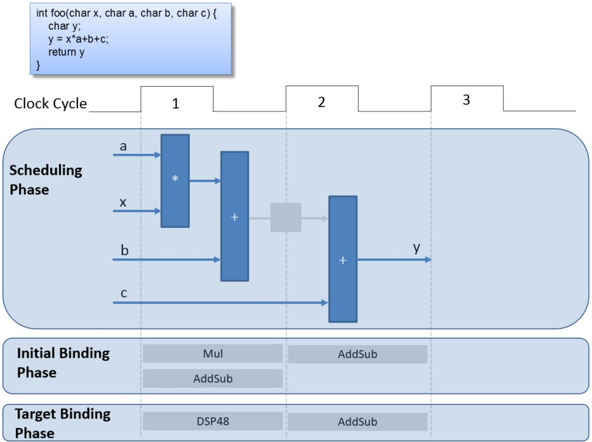
Untimed to Timed
Scheduling
Determines which operations occur during each clock cycle
Binding
Determines which hardware resource implements each scheduled operation
Control logic extraction
Extracts the control logic to create a finite state machine (FSM) that sequences the operations in the RTL design

Slide 13
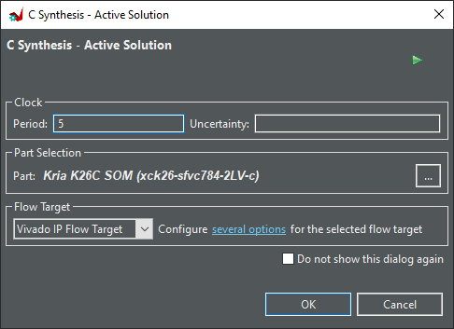
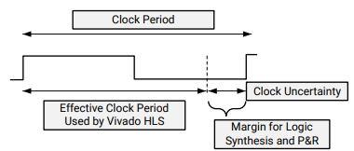
Clock Definition
Clock frequency & selected device used to determine timing of operations – Scheduling Phase
Uncertainty leaves time for final component placement and net routing
If left blank 27% is used

Slide 14
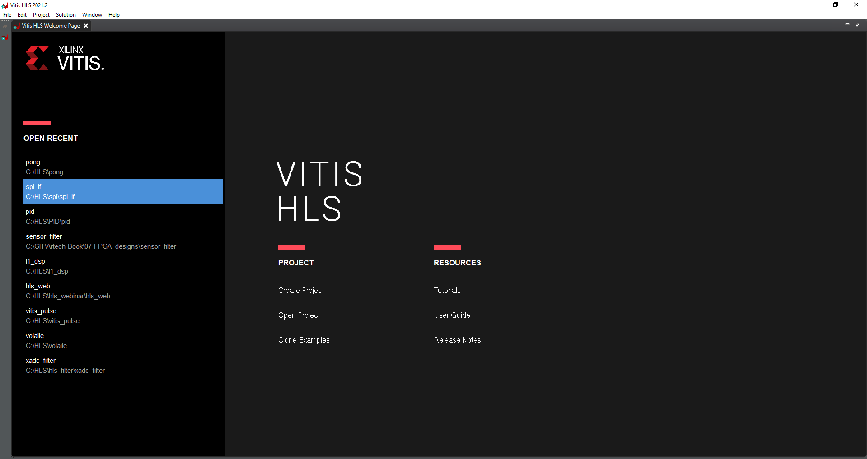
Lab 1: Vitis HLS Flow
Lab 1
Step 1 – Open Vitis HLS 2021.2 and create a new project

Slide 15
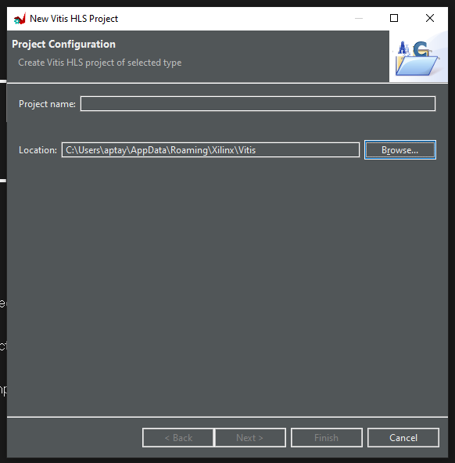
Lab 1: Vitis HLS Flow
Lab 1
Step 1 – Enter a project name and select a location and click next

Slide 16
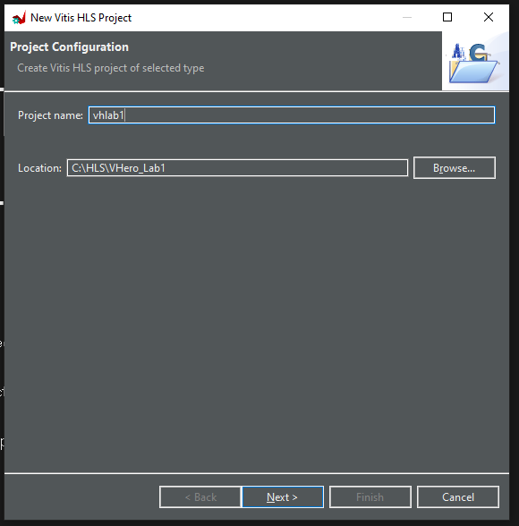
Lab 1: Vitis HLS Flow
Lab 1
Step 1 – I used the name VHlab1

Slide 17
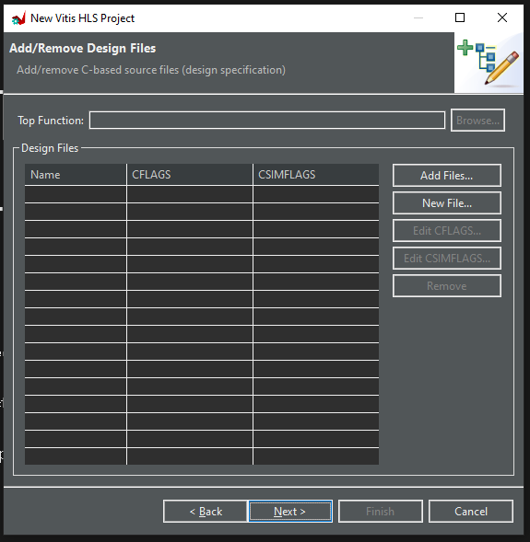
Lab 1: Vitis HLS Flow
Lab 1
Step 1 – Click Next

Slide 18
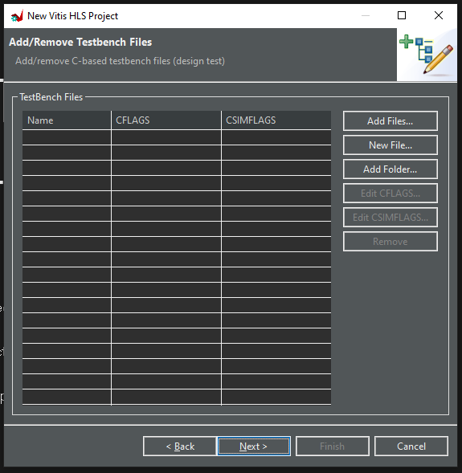
Lab 1: Vitis HLS Flow
Lab 1
Step 1 – Click Next

Slide 19
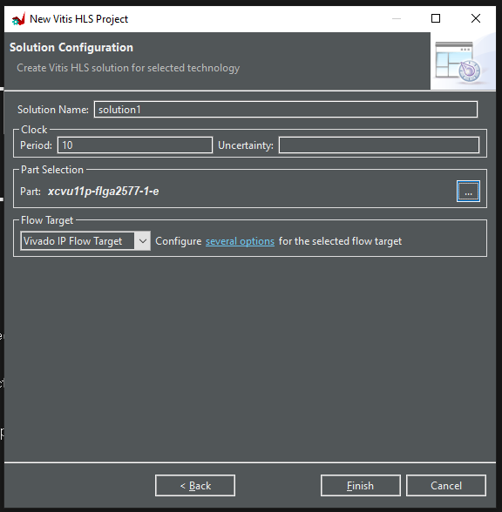
Lab 1: Vitis HLS Flow
Lab 1
Step 1 – Leave all unchanged except for part selection, click to select

Slide 20
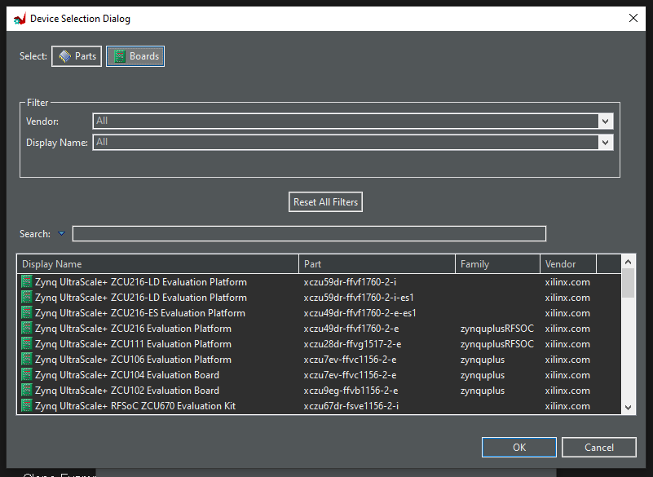
Lab 1: Vitis HLS Flow
Lab 1
Step 1 – Select board and select the SP701 Spartan 7 Board, Click OK

Slide 21
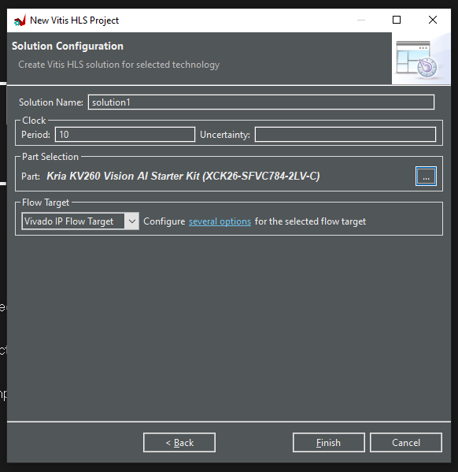
Lab 1: Vitis HLS Flow
Lab 1
Step 1 – Click Finish to create the project

Slide 22
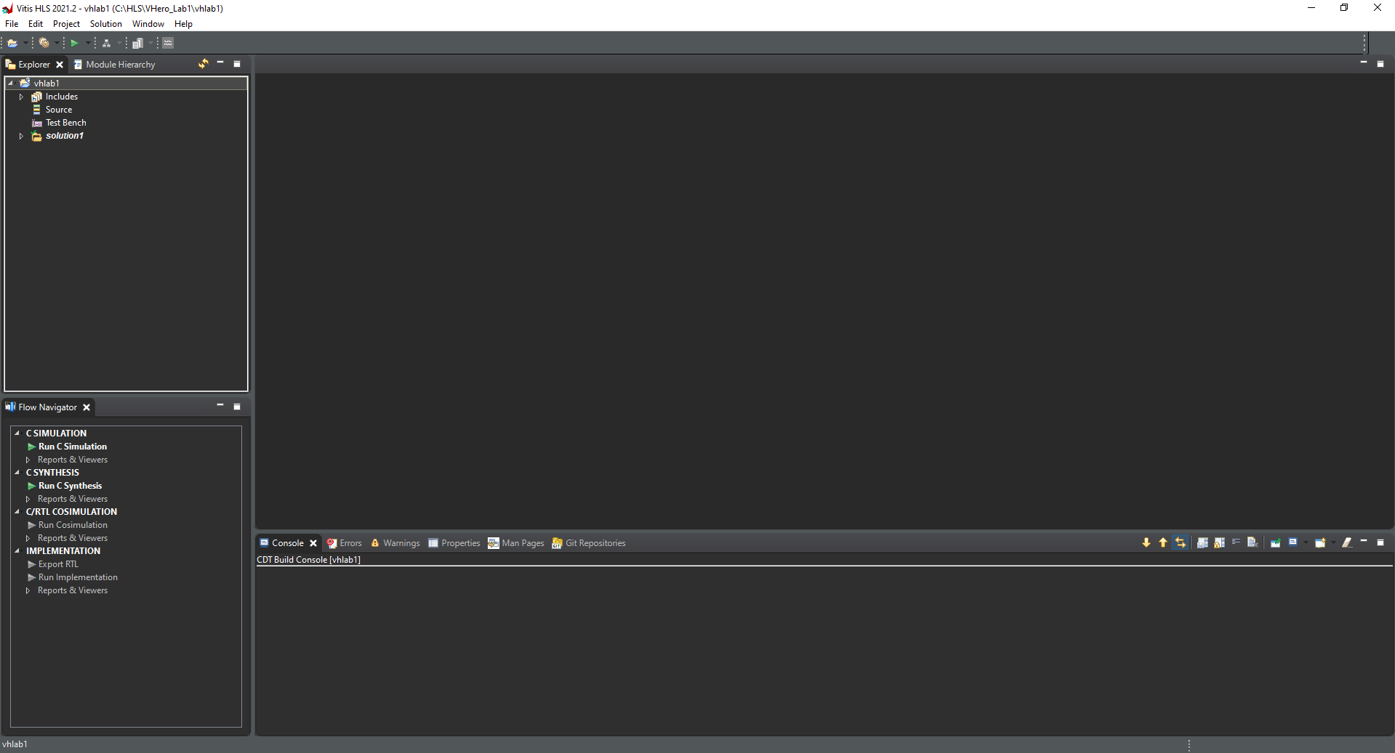
Lab 1: Vitis HLS Flow
Lab 1
Step 1 – This will open the project ready for us to create the application

Slide 23
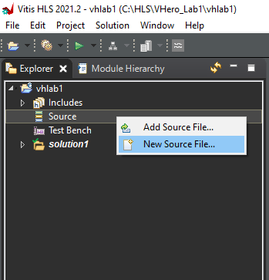
Lab 1: Vitis HLS Flow
Lab 1
Step 1 – Right Click on Source and Select new Source File

Slide 24
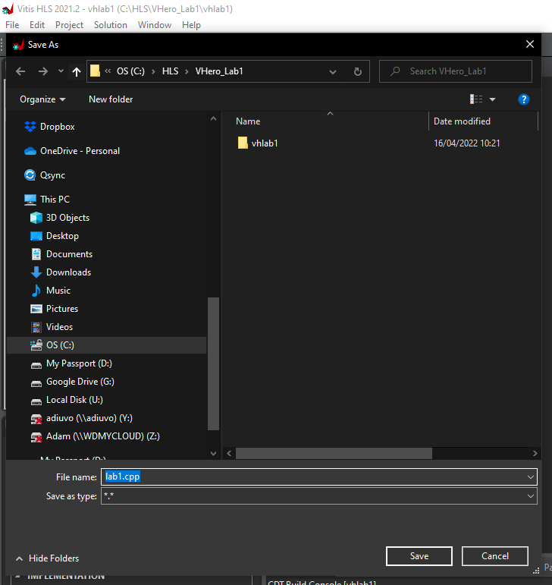
Lab 1: Vitis HLS Flow
Lab 1
Step 1 – Enter the name of the file as lab1.cpp, click save

Slide 25
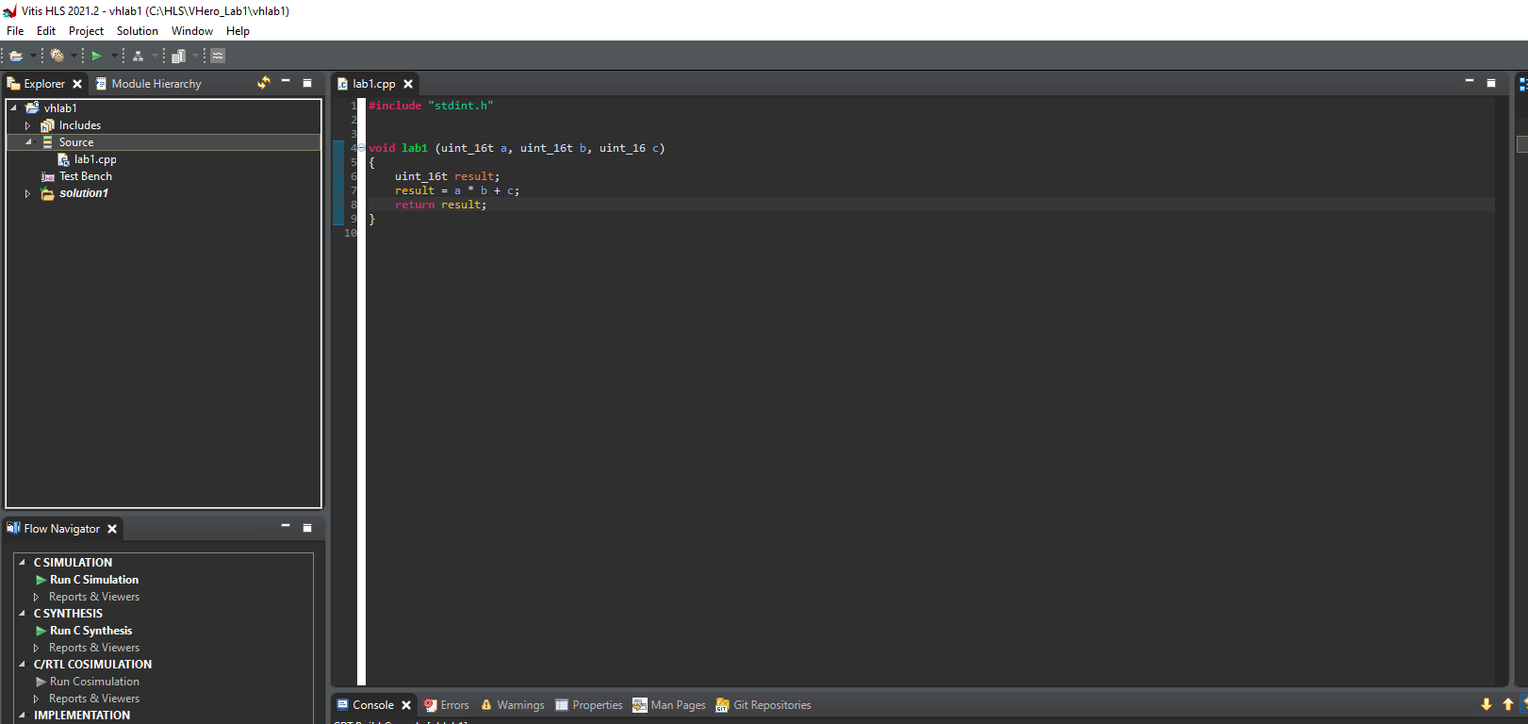
Lab 1: Vitis HLS Flow
Lab 1
Step 1 – Enter the code as below – or Copy from the files on the GitHub. Save the file.

Slide 26
Lab 1: Vitis HLS Flow
Lab 1
Step 1 – Right Click on Source and Select new Source File

Slide 27
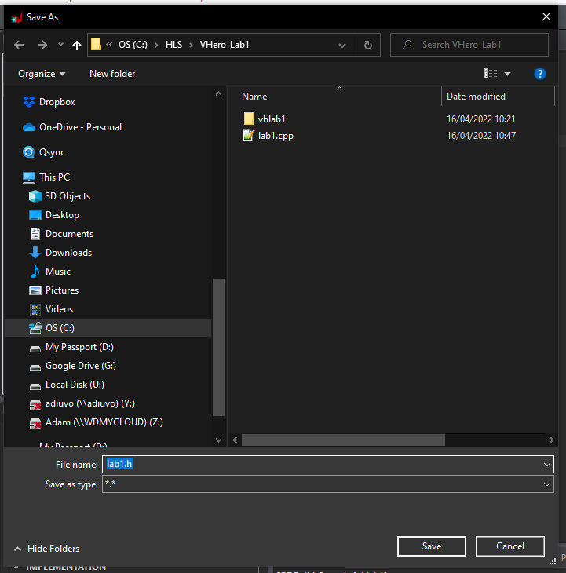
Lab 1: Vitis HLS Flow
Lab 1
Step 1 – Enter the name of the file as lab1.h click save

Slide 28
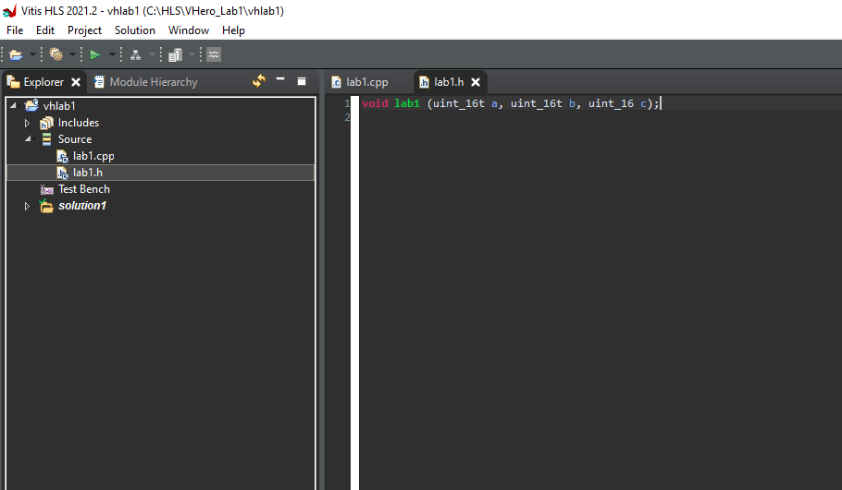
Lab 1: Vitis HLS Flow
Lab 1
Step 1 – Enter the code as below – or Copy from the files on the GitHub. Save the file.

Slide 29
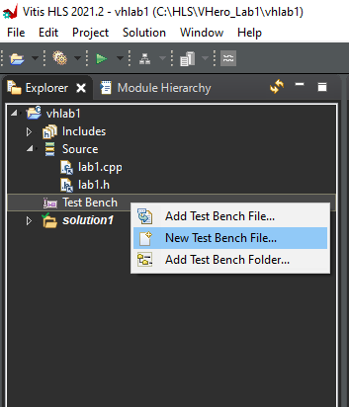
Lab 1: Vitis HLS Flow
Lab 1
Step 1 – Right Click on Test Bench and Select new Test Bench File.

Slide 30
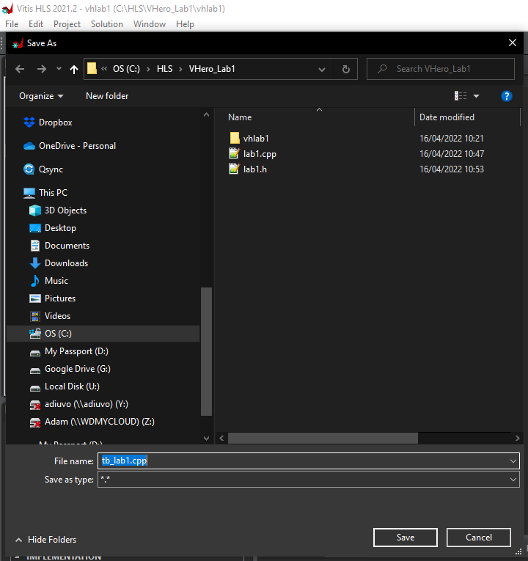
Lab 1: Vitis HLS Flow
Lab 1
Step 1 – Enter the name of the file as tb_lab1.cpp click save

Slide 31
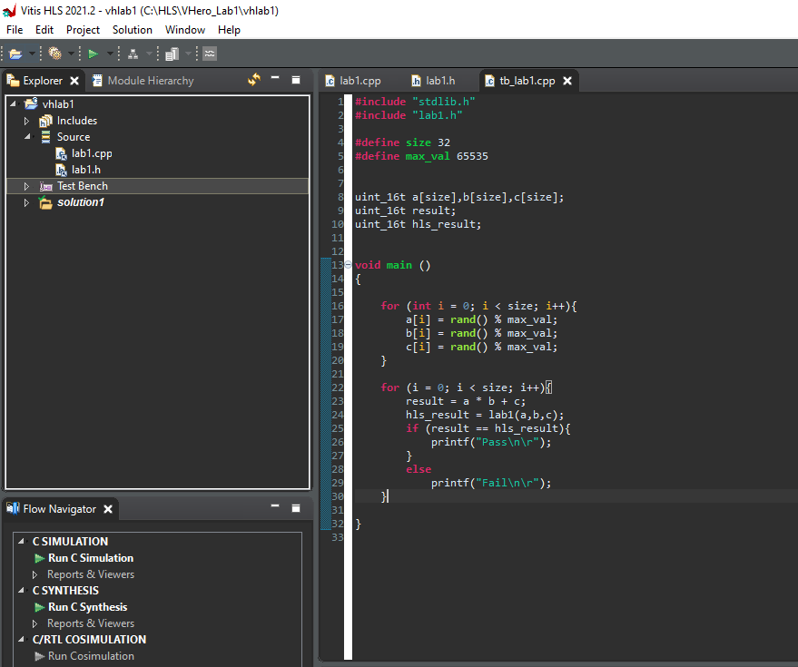
Lab 1: Vitis HLS Flow
Lab 1
Step 1 – Enter the code as below – or Copy from the files on the GitHub. Save the file.

Slide 32
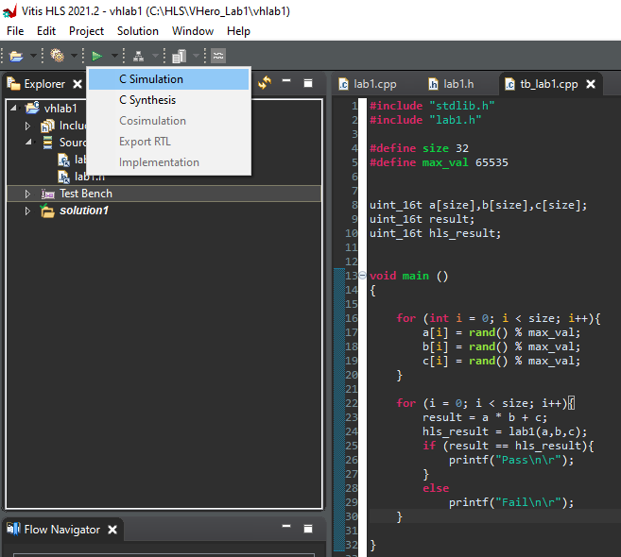
Lab 1: Vitis HLS Flow
Lab 1
Step 1 – From the Run menus select C Simulation

Slide 33
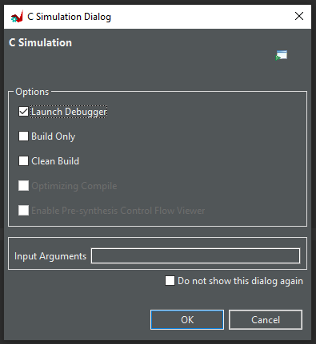
Lab 1: Vitis HLS Flow
Lab 1
Step 1 – On the dialog box select the launch debugger option, click OK

Slide 34
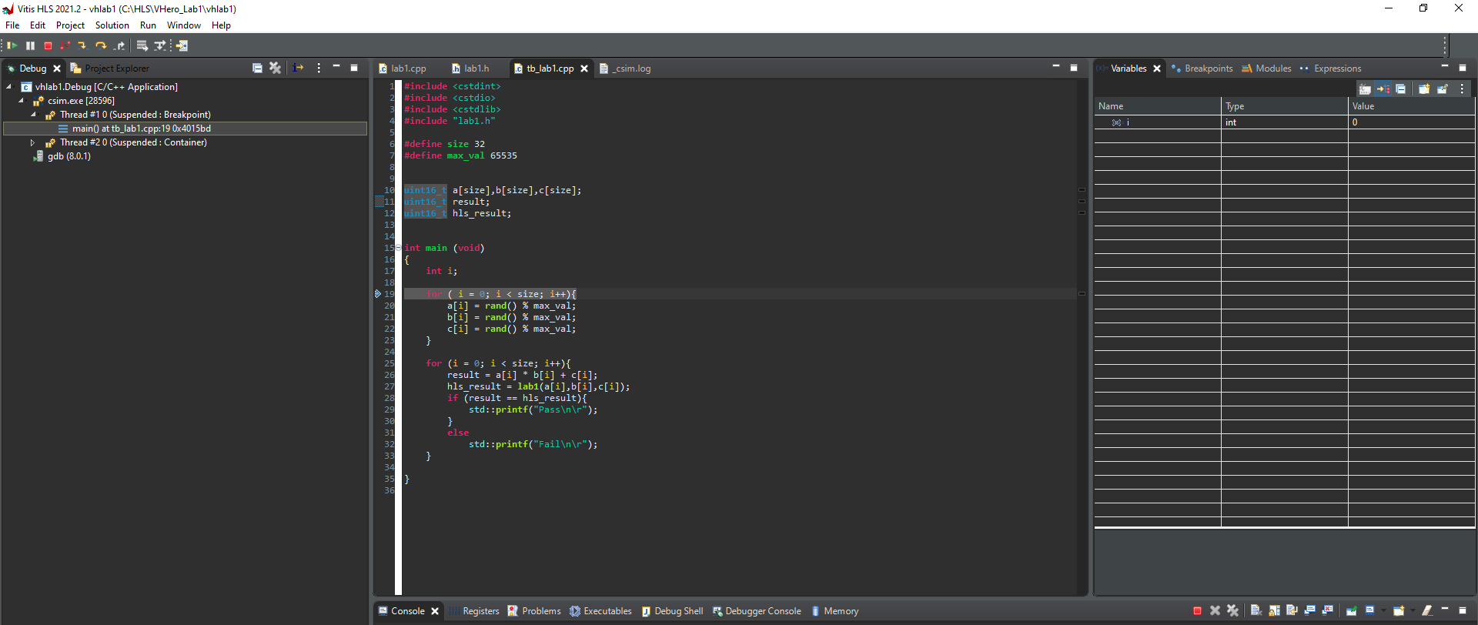
Lab 1: Vitis HLS Flow
Lab 1
Step 1 – This will open the debugger view, with the program paused for execution – we can run, pause, single step using the menu, along with insert breakpoints

Slide 35
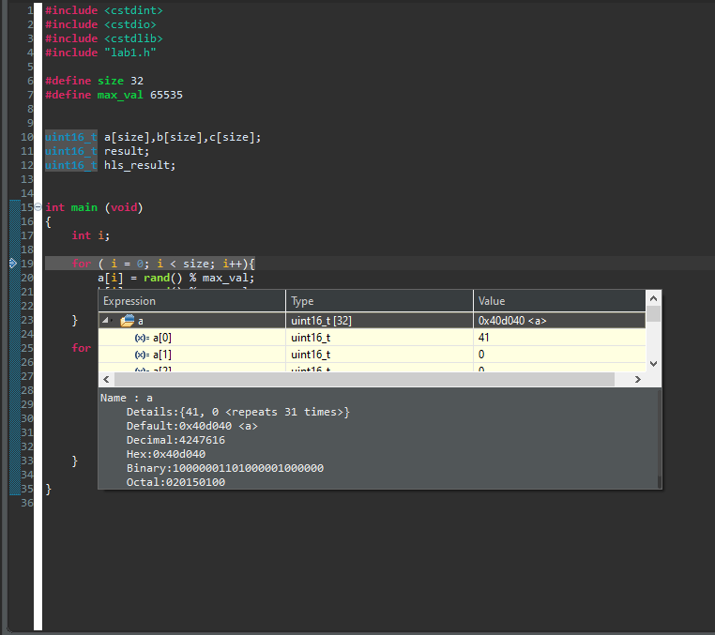
Lab 1: Vitis HLS Flow
Lab 1
Step 1 – Single Step a few of the instructions, hold the pointer over a variable and notice the contents pop up for inspection

Slide 36
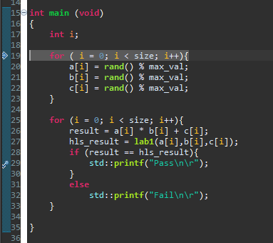
Lab 1: Vitis HLS Flow
Lab 1
Step 1 – Double click in the margin of line 29 to insert a breakpoint – this will be shown by a blue circle.

Slide 37
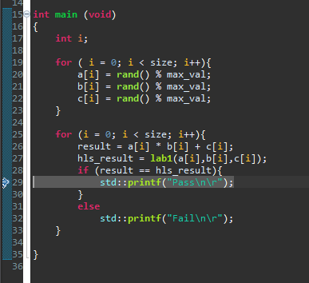
Lab 1: Vitis HLS Flow
Lab 1
Step 1 – Click Run and you will see the breakpoint be hit, double click again in the margin to remove the breakpoint and hit run.

Slide 38
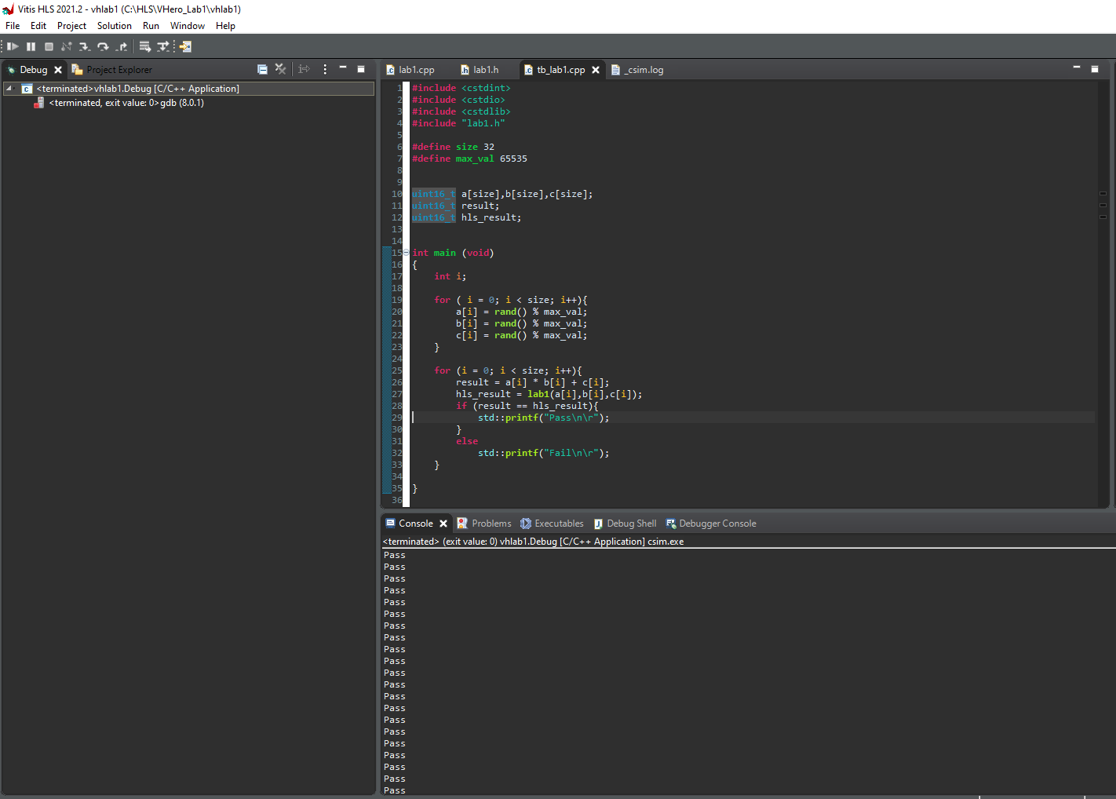
Lab 1: Vitis HLS Flow
Lab 1
Step 1 – The application should run through, outputting pass or fail in the console and then terminate its run.

Slide 39
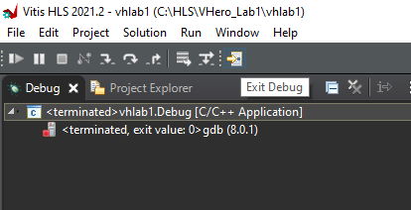
Lab 1: Vitis HLS Flow
Lab 1
Step 1 – Exit the debug display by clicking exit debug

Slide 40
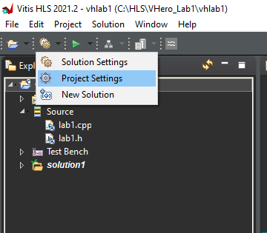
Lab 1: Vitis HLS Flow
Lab 1
Step 1 – From the setting menu select Project Settings

Slide 41
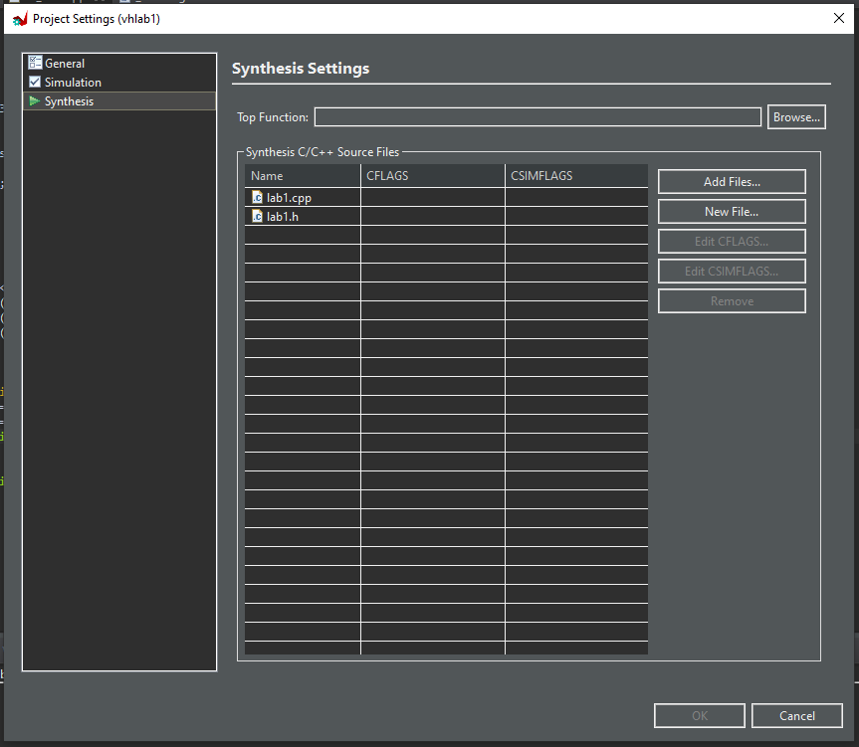
Lab 1: Vitis HLS Flow
Lab 1
Step 1 – Select Browse to select the top function

Slide 42
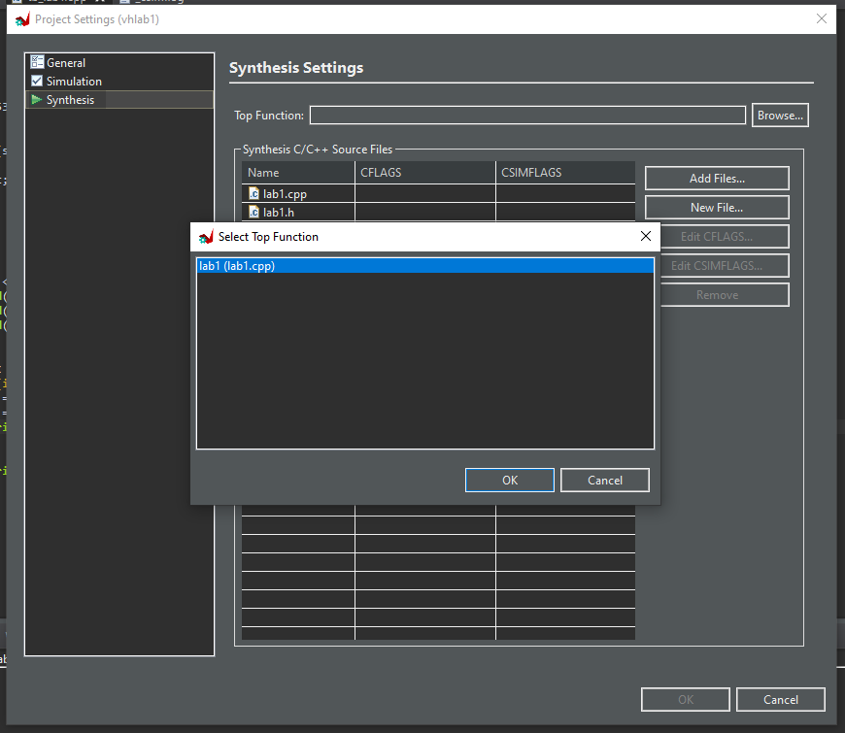
Lab 1: Vitis HLS Flow
Lab 1
Step 1 – Select lab1 (or the name of your function if you named it differently)

Slide 43

Lab 1: Vitis HLS Flow
Lab 1
Step 1 – Click OK

Slide 44
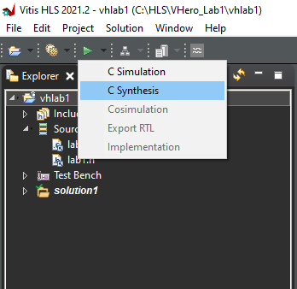
Lab 1: Vitis HLS Flow
Lab 1
Step 1 – Click on run and select C Synthesis

Slide 45
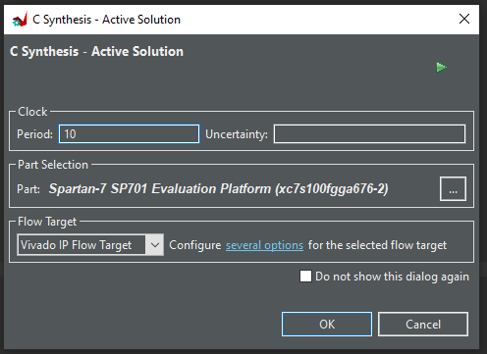
Lab 1: Vitis HLS Flow
Lab 1
Step 1 – Leave all options unchanged and select OK

Slide 46
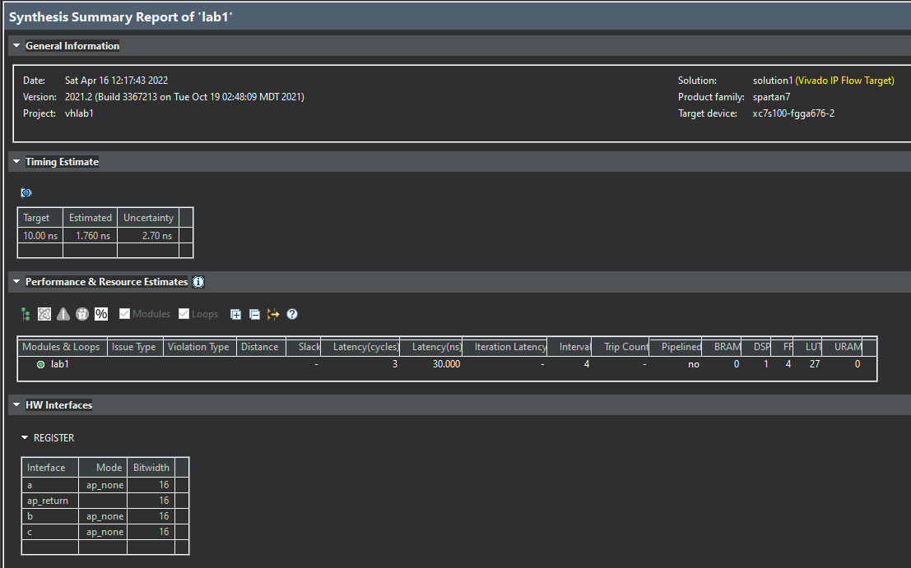
Lab 1: Vitis HLS Flow
Lab 1
Step 1 – Once synthesis is complete you will see the report open notice the resources and interfaces

Slide 47
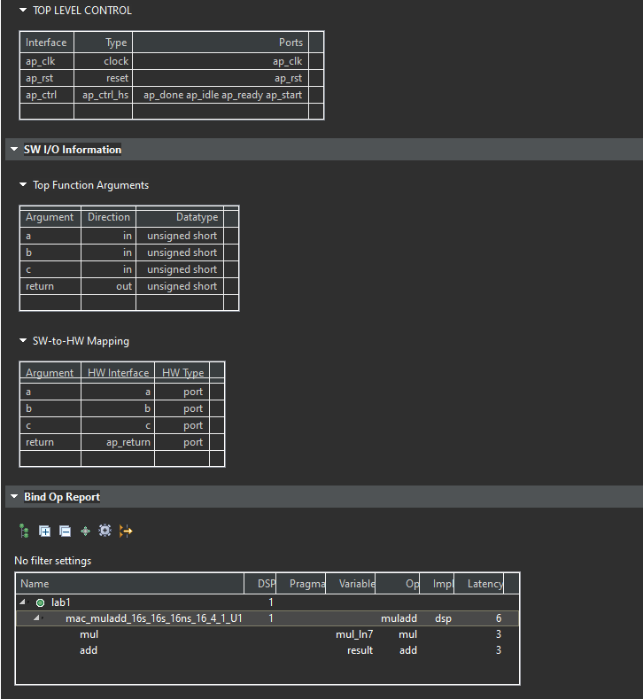
Lab 1: Vitis HLS Flow
Lab 1
Step 1 – Scroll down the report you will see the Top level Controls and Interface Info

Slide 48
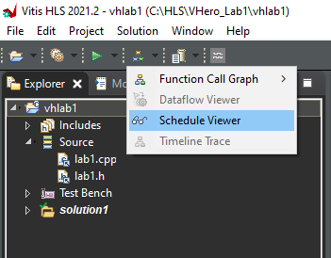
Lab 1: Vitis HLS Flow
Lab 1
Step 1 – From the Schedule menu select Schedule View

Slide 49
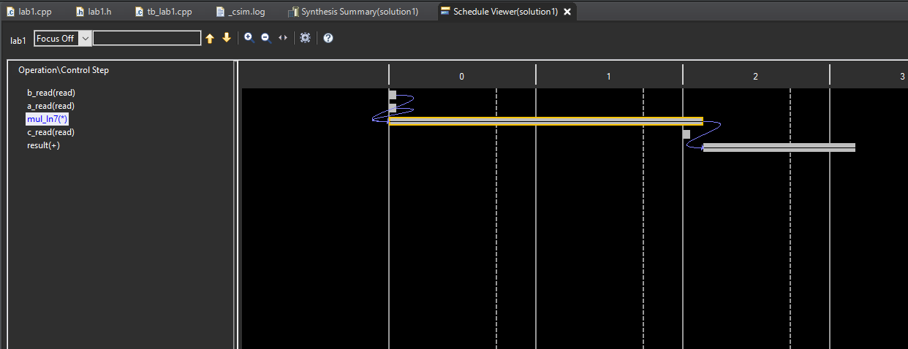
Lab 1: Vitis HLS Flow
Lab 1
Step 1 – Examine the schedule view

Slide 50
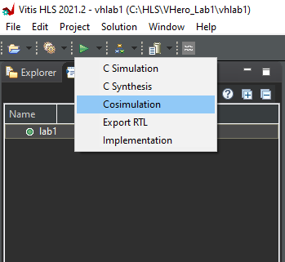
Lab 1: Vitis HLS Flow
Lab 1
Step 1 – From the run menu select Co-Simulation

Slide 51
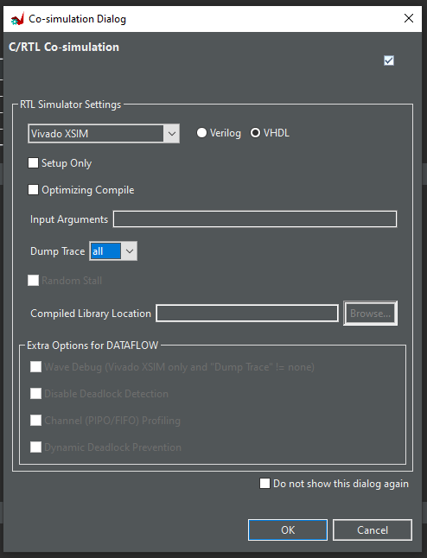
Lab 1: Vitis HLS Flow
Lab 1
Step 1 – Leave the options unchanged and click OK

Slide 52
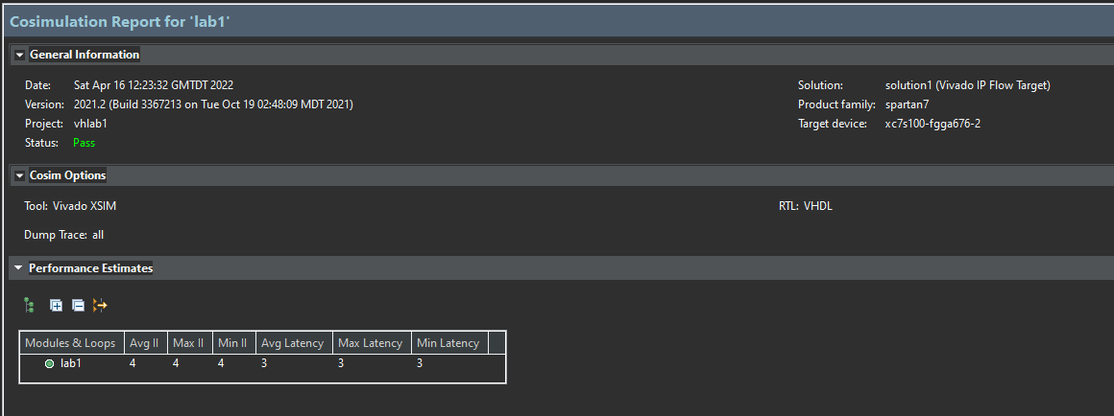
Lab 1: Vitis HLS Flow
Lab 1
Step 1 – Observe the report which shows the completion of the Co Simulation and pass / fail.

Slide 53
Lab 1 Summary
Lab 1 Summary
The concludes lab 1, throughout this lab we have demonstrated
How to create a project in Vitis HLS
How to create source and test benches
How to run C simulation
How to set up the project for synthesis
How to synthesize the design
How to run Co-Simulaiton

Slide 54
Lab 2 Vitis HLS Interfacing

Slide 55
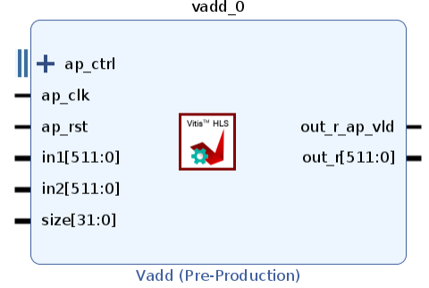
Interfacing
Interfacing depends on flow
Vitis - XO
AXI – Data Accessed via Memory Map
AXIS – Data Accessed via Stream
AXI Lite – Register Access
Vivado – IP XACT
Block Level – Controls Flow / Status
Protocol Level – Controls

Slide 56
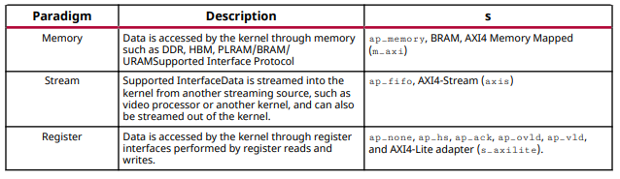
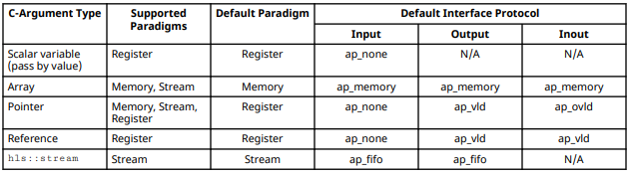
Vivado Interfacing
Instantiate appropriate interface to integrate with design
Do we want to start and stop block, synchronize or be data driven.
Are we controlling the block from SW
What about data interfaces.

Slide 57
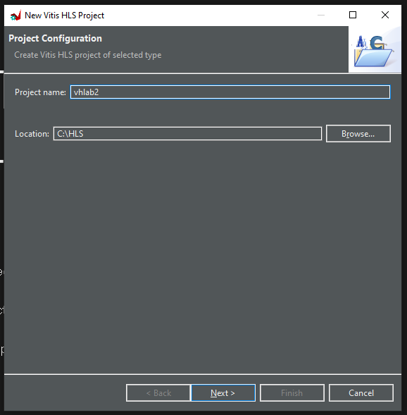
Lab 2: Vitis HLS Interfacing
Lab 2
Step 1 – Create a new project called VHLab2, click OK.

Slide 58
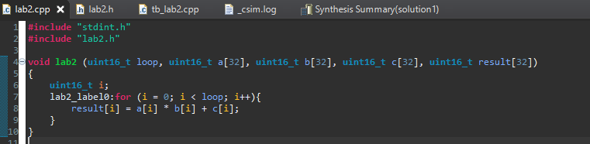
Lab 2: Vitis HLS Interfacing
Lab 2
Step 1 – Create a new source file called lab2.cpp and enter the code below or copy from the GitHub.

Slide 59
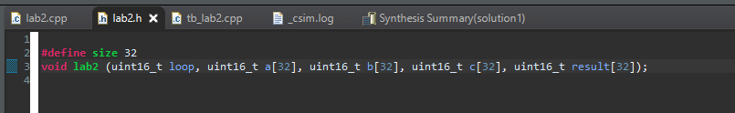
Lab 2: Vitis HLS Interfacing
Lab 2
Step 1 – Create a new source file called lab2.h and enter the code below or copy from the GitHub.

Slide 60
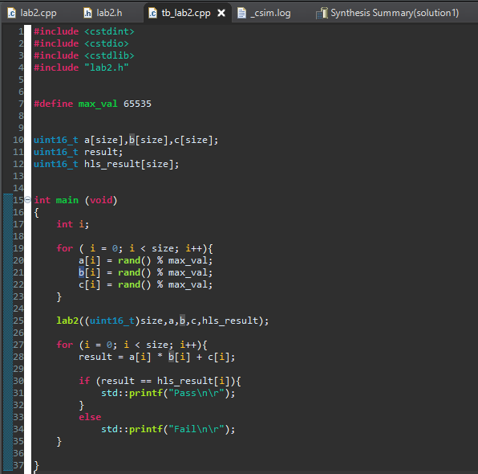
Lab 2: Vitis HLS Interfacing
Lab 2
Step 1 – Create a new source file called tb_lab2.cpp and enter the code below or copy from the GitHub.

Slide 61
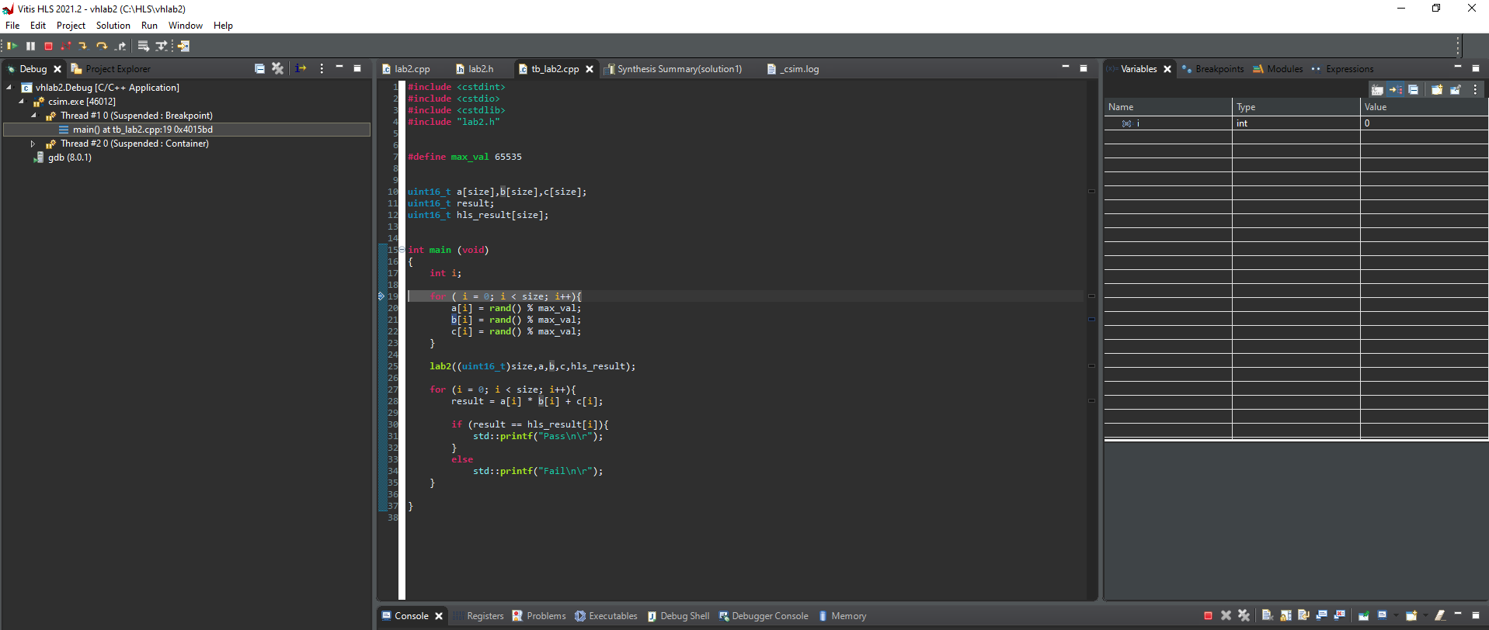
Lab 2: Vitis HLS Interfacing
Lab 2
Step 1 – Run a C Simulation in the debugger, notice how this time the application is batch based

Slide 62

Lab 2: Vitis HLS Interfacing
Lab 2
Step 1 – Close the C Simulation and open the Lab2.cpp file, select the directives' view. Right click on the lb2_label0 and select Insert Directive.

Slide 63

Lab 2: Vitis HLS Interfacing
Lab 2
Step 1 – Insert the directive LOOP_TRIPCOUNT this informs the tool how many times the loop will execute in the maximum case.

Slide 64

Lab 2: Vitis HLS Interfacing
Lab 2
Step 1 – Run the Synthesis you will notice the Trip Count is now recorded under the lab2 label0

Slide 65

Lab 2: Vitis HLS Interfacing
Lab 2
Step 1 – Examine the HW Interfaces and notice the RAM Interfaces are AP_MEMORY and Register Interfaces.

Slide 66

Lab 2: Vitis HLS Interfacing
Lab 2
Step 1 – In the synthesis view add in a new directive for the source code for the port loop. Select INTERFACE directive and for the mode select S_AXILITE

Slide 67

Lab 2: Vitis HLS Interfacing
Lab 2
Step 1 – In the synthesis view add in a new directive for the source code for the function. Select INTERFACE directive and for the mode select S_AXILITE

Slide 68

Lab 2: Vitis HLS Interfacing
Lab 2
Step 1 – The Directives should appear as shown in the directives tab – Rerun synthesis

Slide 69

Lab 2: Vitis HLS Interfacing
Lab 2
Step 1 – Examine the HW Interfaces in the report and notice control of the block and loop register are now AXI registers

Slide 70
Lab 2 Summary
Lab 2 Summary
The concludes lab 2, throughout this lab we have demonstrated
How to inform the synthesis tool about number of loop iterations
How to control register interfaces to use AXI Interfaces
How to control the IP Block control signals be Implemented as AXI

Slide 71
Lab 3 Vitis HLS Optimization

Slide 72

Lab 3: Vitis HLS Optimization
Lab 3
Step 1 – Create a new project called VHlab3.cpp

Slide 73

Lab 3: Vitis HLS Optimization
Lab 3
Step 1 – Create a new source file called lab3.cpp and enter the code below or copy from the GitHub.

Slide 74

Lab 3: Vitis HLS Optimization
Lab 3
Step 1 – Create a new source file called lab3.h and enter the code below or copy from the GitHub.

Slide 75

Lab 3: Vitis HLS Optimization
Lab 3
Step 1 – Create a new source file called tb_lab3.cpp and enter the code below or copy from the GitHub.

Slide 76

Lab 3: Vitis HLS Optimization
Lab 3
Step 1 – Right Click on Test Bench File and select add Test Bench File

Slide 77

Lab 3: Vitis HLS Optimization
Lab 3
Step 1 – Add in the input.dat file provided on the GitHub

Slide 78

Lab 3: Vitis HLS Optimization
Lab 3
Step 1 – Run the C Simulation and ensure the result is as shown below.

Slide 79

Lab 3: Vitis HLS Optimization
Lab 3
Step 1 – Select the top function of Sensor_Filter to allow synthesis – perform synthesis.

Slide 80

Lab 3: Vitis HLS Optimization
Lab 3
Step 1 – Observe the synthesis interval and resources reported in the synthesis report.

Slide 81

Lab 3: Vitis HLS Optimization
Lab 3
Step 1 – Open the Function Call Graph for the Synthesis.

Slide 82

Lab 3: Vitis HLS Optimization
Lab 3
Step 1 – Observe the information presented, change the heat map.

Slide 83

Lab 3: Vitis HLS Optimization
Lab 3
Step 1 – In the directives view for the source code add in a pragma to unroll the loop labelled accum.

Slide 84

Lab 3: Vitis HLS Optimization
Lab 3
Step 1 – In the directives view for the source code add in a pragma to partition the array Input .

Slide 85

Lab 3: Vitis HLS Optimization
Lab 3
Step 1 – Rerun synthesis and observe the interval and resources again.

Slide 86
Lab 3 Summary
Lab 3 Summary
The concludes lab 3, throughout this lab we have demonstrated
How to add optimization pragmas
How optimization pragma will change the resource and latency performance
How to visualize the optimization impacts

Slide 87
Lab 4 Vitis HLS Arbitrary Precision Math

Slide 88

Lab 4: Vitis HLS Arbitrary Precision Math
Lab 4
Step 1 – Create a new project called vhlab4.

Slide 89

Lab 4: Vitis HLS Arbitrary Precision Math
Lab 4
Step 1 – Create a new source file called lab4.cpp and enter the code below or copy from the GitHub.

Slide 90

Lab 4: Vitis HLS Arbitrary Precision Math
Lab 4
Step 1 – Create a new source file called lab4.h and enter the code below or copy from the GitHub.

Slide 91

Lab 4: Vitis HLS Arbitrary Precision Math
Lab 4
Step 1 – Create a new source file called tb_lab4.cpp and enter the code below or copy from the GitHub.

Slide 92

Lab 4: Vitis HLS Arbitrary Precision Math
Lab 4
Step 1 – Run the Synthesis observe the interval and the resources required.

Slide 93

Lab 4: Vitis HLS Arbitrary Precision Math
Lab 4
Step 1 – Examine the analysis view to see the operations involved.

Slide 94

Lab 4: Vitis HLS Arbitrary Precision Math
Lab 4
Step 1 – In the file lab4.h comment out the line define float_type.

Slide 95

Lab 4: Vitis HLS Arbitrary Precision Math
Lab 4
Step 1 – Rerun synthesis and observe the interval and resources.

Slide 96
Lab 4 Summary
Lab 4 Summary
The concludes lab 4, throughout this lab we have demonstrated
How to switch between floating point and arbitrary precision in your application
The benefit of using arbitrary precision numbers
The difference in performance between the use of floating-point vs arbitrary precision

Slide 97
Lab 5 Vitis HLS Vitis Libraries

Slide 98

Lab 5: Vitis HLS Vitis Libraries
Lab 5
Step 1 – Open the Vitis libraries repository in GitHub.

Slide 99

Lab 5: Vitis HLS Vitis Libraries
Lab 5
Step 1 – Download or clone the repository.

Slide 100

Lab 5: Vitis HLS Vitis Libraries
Lab 5
Step 1 – If you downloaded the Zip Extract the files .

Slide 101

Lab 5: Vitis HLS Vitis Libraries
Lab 5
Step 1 – Create a project called vhlab5.

Slide 102

Lab 5: Vitis HLS Vitis Libraries
Lab 5
Step 1 – Right click on source and select Add Source File .

Slide 103

Lab 5: Vitis HLS Vitis Libraries
Lab 5
Step 1 – Select the files, data_path.hpp, top_module.cpp and top_module.hpp from the location
<install>\Vitis_Libraries\dsp\L1\examples\1Dfix_impluse\src

Slide 104

Lab 5: Vitis HLS Vitis Libraries
Lab 5
Step 1 – Right click on Test Bench and select Add Source File .

Slide 105

Lab 5: Vitis HLS Vitis Libraries
Lab 5
Step 1 – Select the file main.cpp from the location
<install>\Vitis_Libraries\dsp\L1\examples\1Dfix_impluse\src

Slide 106

Lab 5: Vitis HLS Vitis Libraries
Lab 5
Step 1 – Select the fft_top as the top function for the project

Slide 107

Lab 5: Vitis HLS Vitis Libraries
Lab 5
Step 1 – Set the Cflags and Csimflags to
-I../../../../../GIT/Vitis_Libraries/dsp/L1/include/hw/vitis_fft/fixed

Slide 108

Lab 5: Vitis HLS Vitis Libraries
Lab 5
Step 1 – Run synthesis this might take some time

Slide 109

Lab 5: Vitis HLS Vitis Libraries
Lab 5
Step 1 – Examine the function call graph

Slide 110

Lab 5: Vitis HLS Vitis Libraries
Lab 5
Step 1 – Examine the Dataflow graph

Slide 111

Lab 5: Vitis HLS Vitis Libraries
Lab 5
Step 1 – Notice there is a timing error,

Slide 112

Lab 5: Vitis HLS Vitis Libraries
Lab 5
Step 1 – Right click on the error and select go to timing violation

Slide 113

Lab 5: Vitis HLS Vitis Libraries
Lab 5
Step 1 – Observe the timing violation in the schedule viewer

Slide 114

Lab 5: Vitis HLS Vitis Libraries
Lab 5
Step 1 – Back in the timing violation, go to the source- notice the line of code causing the delay is highlighted.

Slide 115
Lab 5 Summary
Lab 5 Summary
The concludes lab 5, throughout this lab we have demonstrated
How to access Vitis Libraries
How to include Level One elements from the library within Vitis HLS
How to include the Vitis libraries to build to application
How to observe the results in the function call and dataflow graph
How to identify a timing violation
How to view the violation in the schedule viewer
How to identify the violation in the source code.

